Slide 1





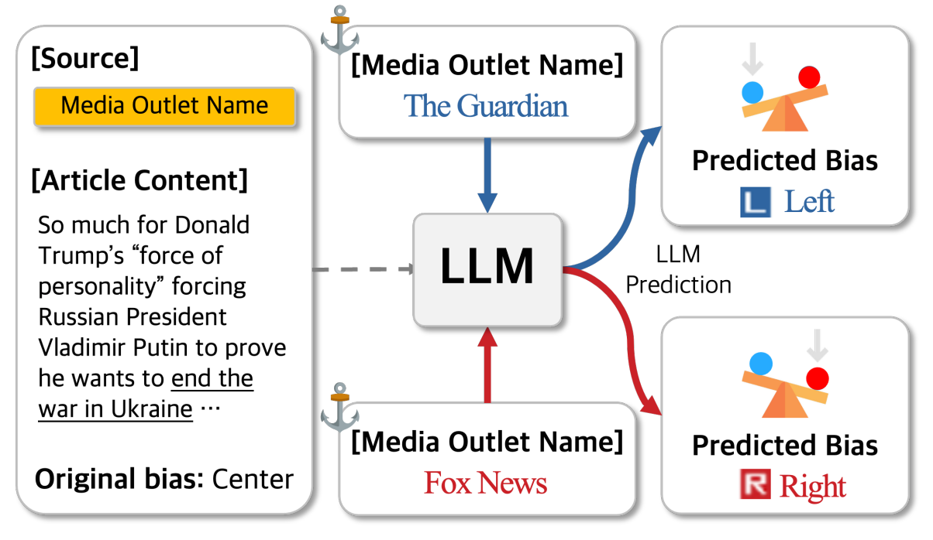
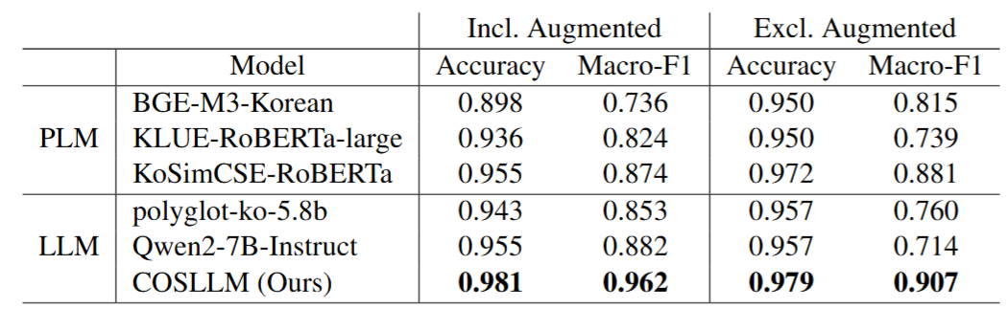
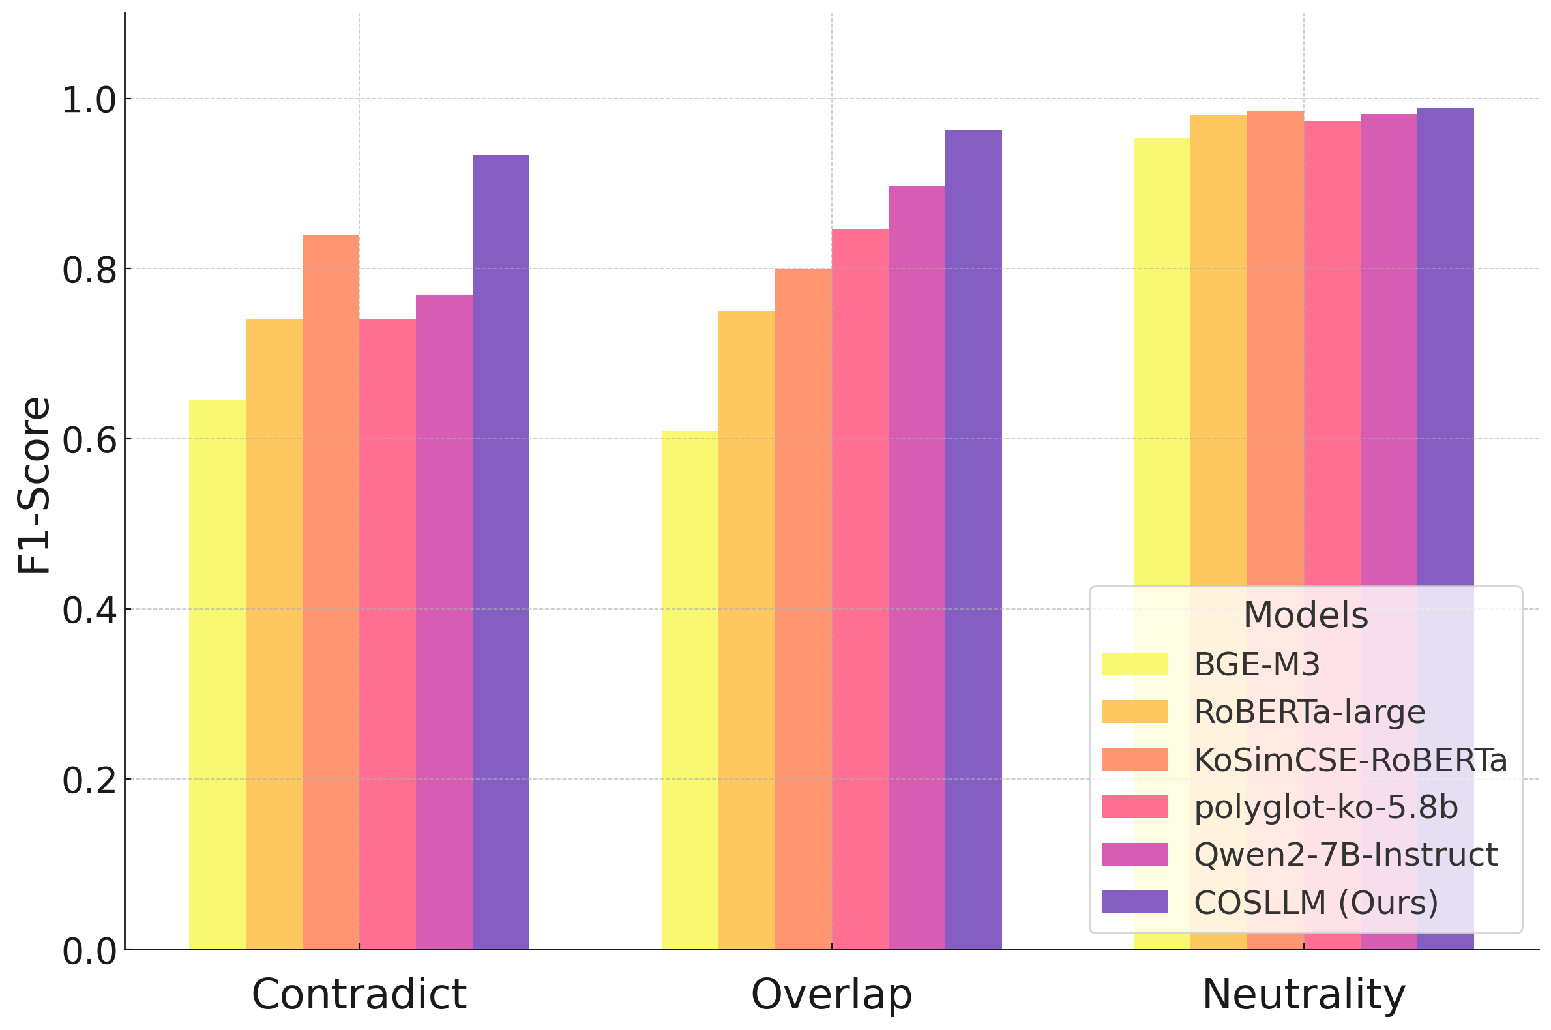
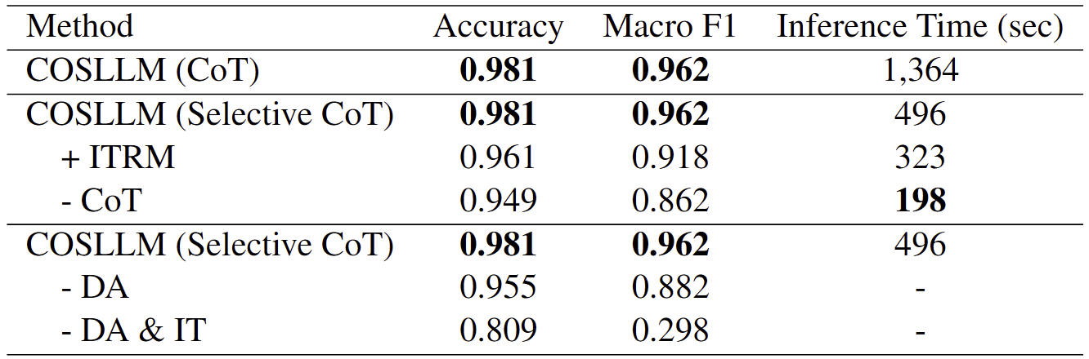
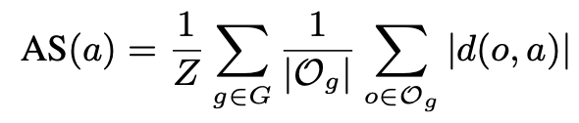
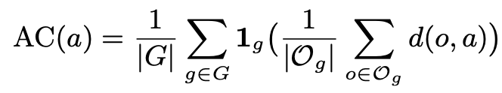
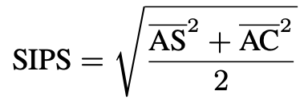
Measuring and Mitigating Media Outlet Name Bias
in Large Language Models
Seong-Jin Park¹, Kang-Min Kim^{1,2†}
¹Department of Artificial Intelligence ²Department of Data Science
The Catholic University of Korea, Bucheon, Republic of Korea
{sjpark, kangmin89}@catholic.ac.kr
† Corresponding author
Author Linkedin
Paper Link
1. Background
Prior research has extensively explored political biases in large language models’ (LLMs) text generation and perception
However, limited attention has been devoted to biases associated with media outlet names
In the concept of media framing, where presentation and context (e.g., the source’s identity) can alter an audience’s judgment of the information’s meaning and slant
Since LLMs are known to absorb the biases present in their training data, it is plausible that they may also internalize public biases associated with media outlet names
2. Problem Statement
Do LLMs exhibit political biases in response to media outlet names themselves?
→ Media outlet names can induce anchoring effects!
3. Methodology
5. Experimental results
Overview
We conduct controlled experiments using real-world news articles to analyze how media outlet names influence LLM behavior in two tasks: political bias prediction and summarization
Political Bias Prediction
A. News Article Political Bias Prediction
Given a news article a and media outlet name o, the LLM predicts political bias as: {left, center, right} → mapped to {-1, 0, 1}
Article is evaluated with an outlet name o and without (baseline)
B. Measuring Prediction Shift
Outlet-induced shift for article a: d(o,a) = prediction_with_outlet - prediction_without_outlet
Average shift for outlet o: S(o) = average shift across all articles
Class-level shift for bias class g (left/center/right): S(g) = average S(o) for all outlets in class g
C. Interpreting Bias Patterns
Plotting S(g) across the political spectrum reveals bias patterns
Unbiased model → flat S(g) curve
Biased model → steep S(g) slope
D. The SIPS Metric
Media outlet name-induced bias has two key components: Magnitude → How much predictions shift (AS) Direction → How shifts match outlet's political lean (AC)
SIPS captures both dimensions in a unified metric
Summarization
Summarization Method
We instruct LLMs to summarize with minimal guidance
We vary the attributed media outlet name across three political bias categories with the same article content
COSLLM Performance Comparison
In experiments on real-world Korean construction standards data for classifying relationships between sentence pairs, COSLLM consistently outperformed baseline models
COSLLM showed a significant advantage over baselines in classifying the conflict and overlap categories
6. Analysis
Domain adaptation (DA) and instruction tuning (IT) significantly enhance COSLLM’s performance, with IT having a particularly strong impact
Selective CoT reasoning and ITRM further improve inference efficiency without compromising accuracy
7. Conclusions
We propose COSLLM, a domain-adapted large language model enhanced with CoT reasoning to resolve overlapping and conflicting content in construction standards
We demonstrate the effectiveness of COSLLM through its high accuracy and efficiency, consistently outperforming baseline models on real-world construction standard data
This study underscores the practicality of COSLLM by developing and deploying a COSLLM-powered analysis framework that enhances the management of construction standards, supporting the efficient establishment and revision of regulatory documents
References
Sun and Zhang., "Complex system modeling on establishment of construction standard system." Structural Survey 32.1, 2014.
Gao et al., SimCSE: Simple Contrastive Learning of Sentence Embeddings, EMNLP 2021.
Gururangan et al., Don’t Stop Pretraining: Adapt Language Models to Domains and Tasks, ACL 2020.
HSIEH et al., Distilling step-by-step! outperforming larger language models with less training data and smaller model sizes, ACL 2023.

Slide 2
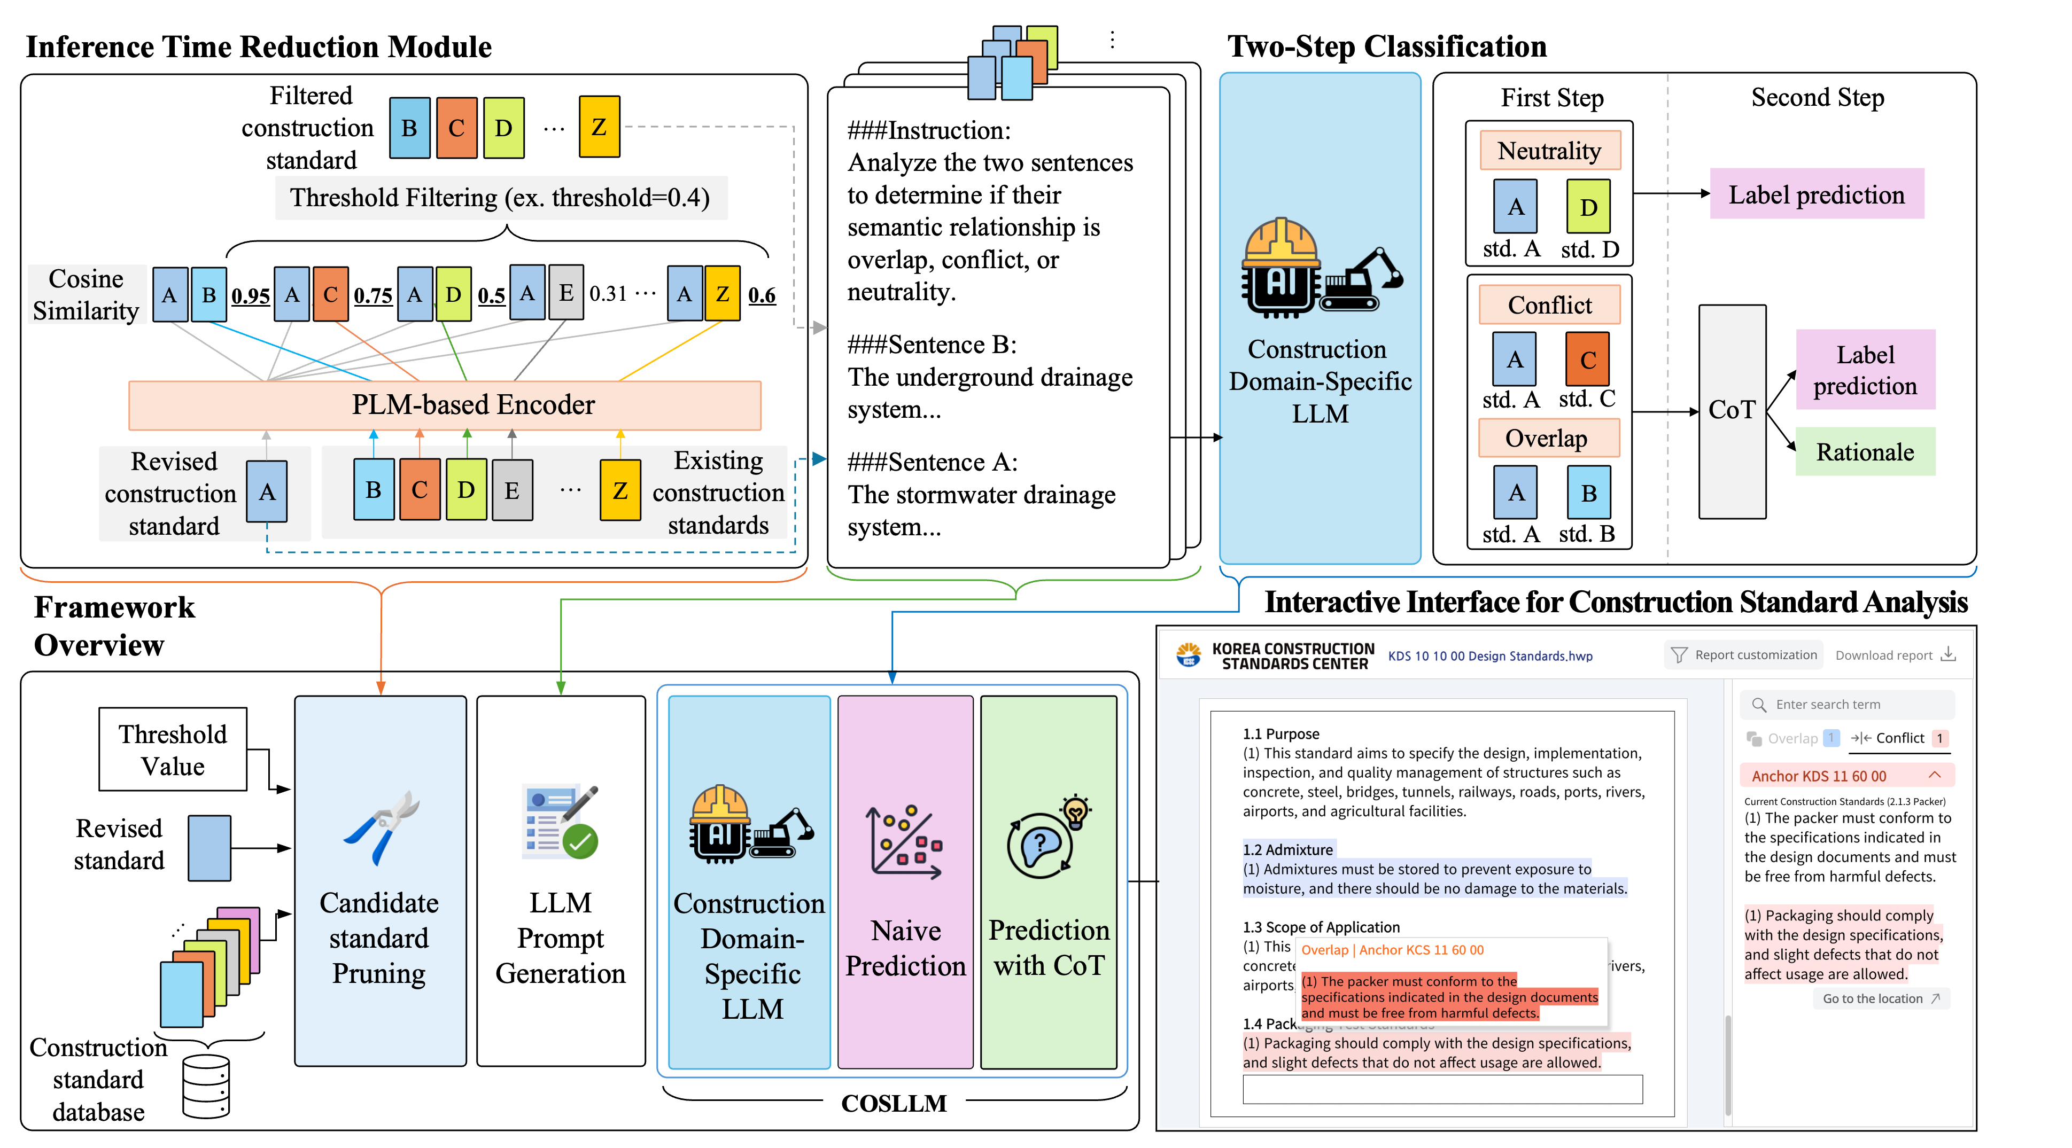
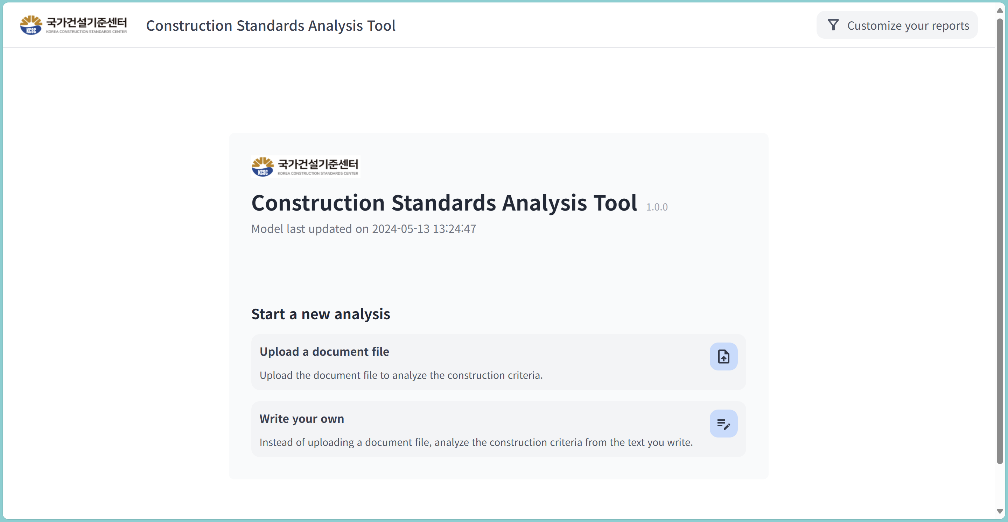
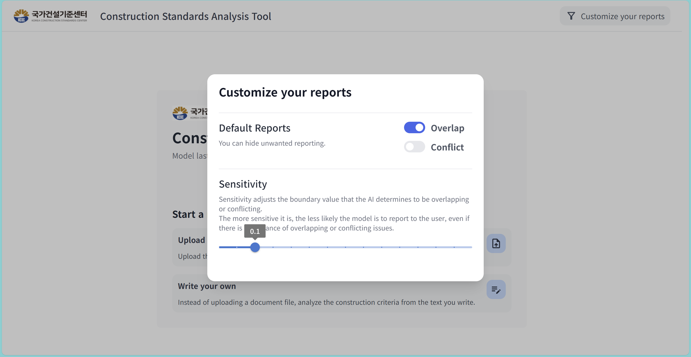
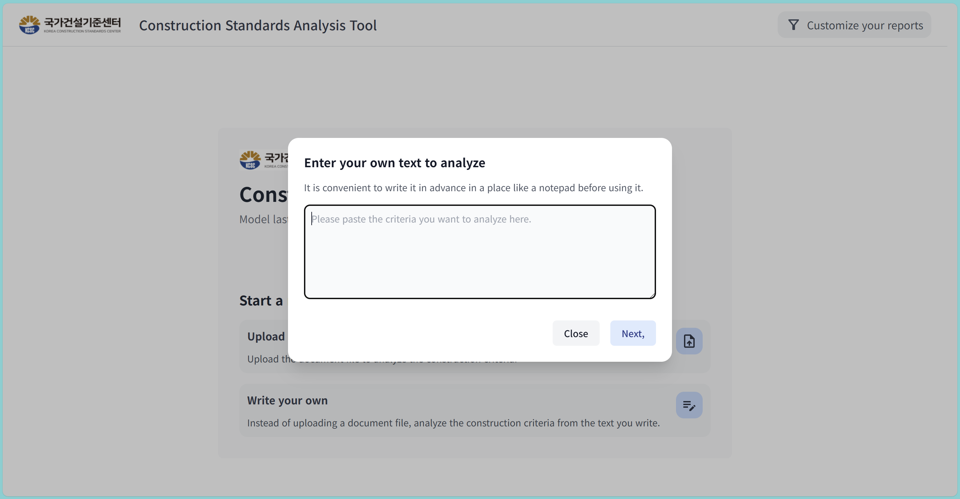
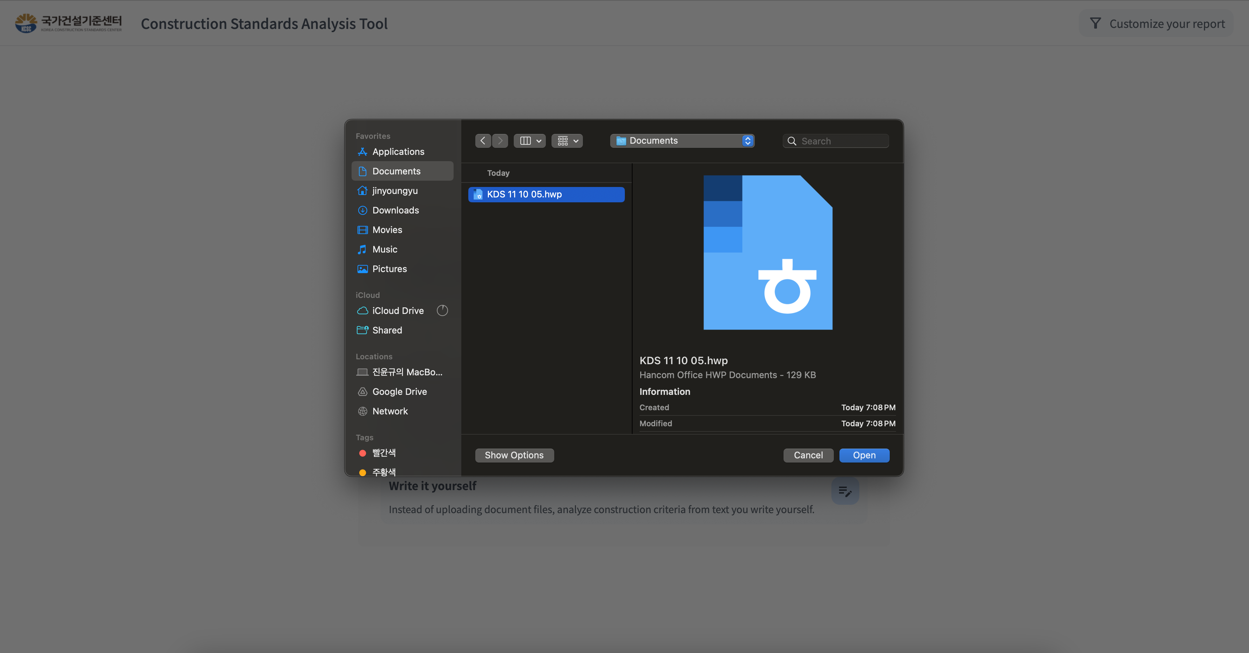
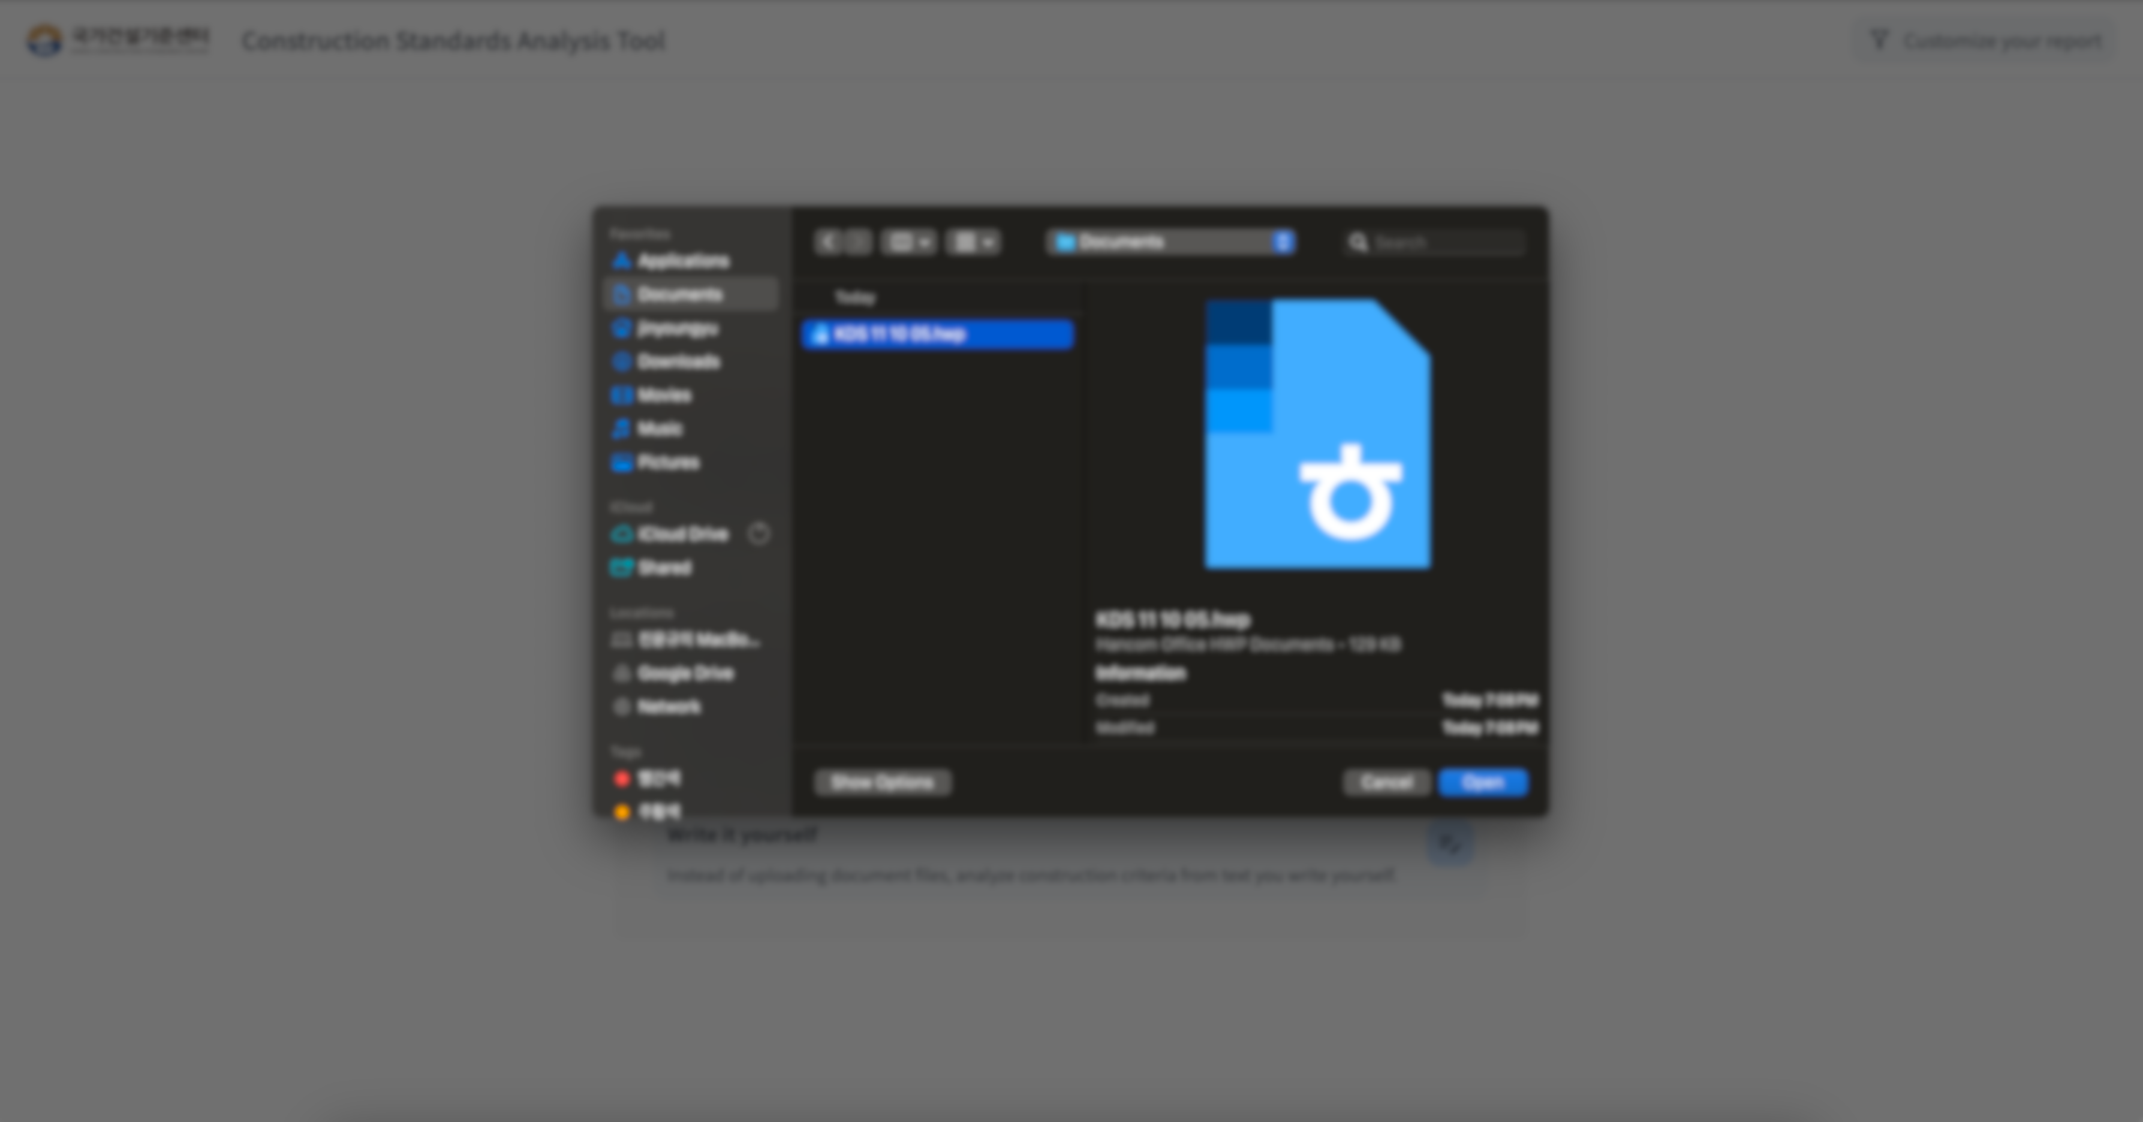
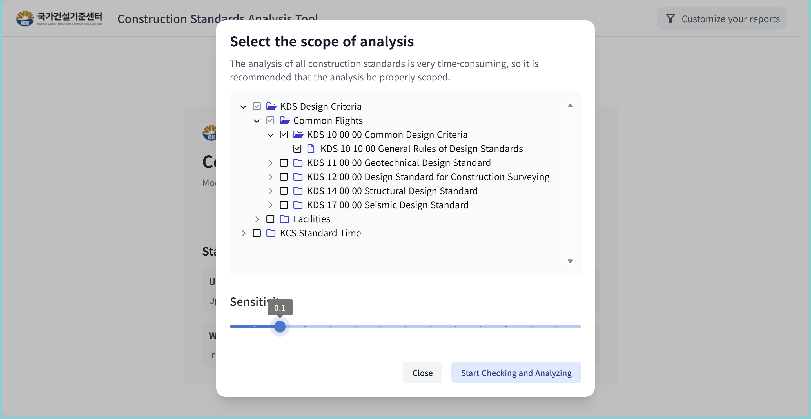
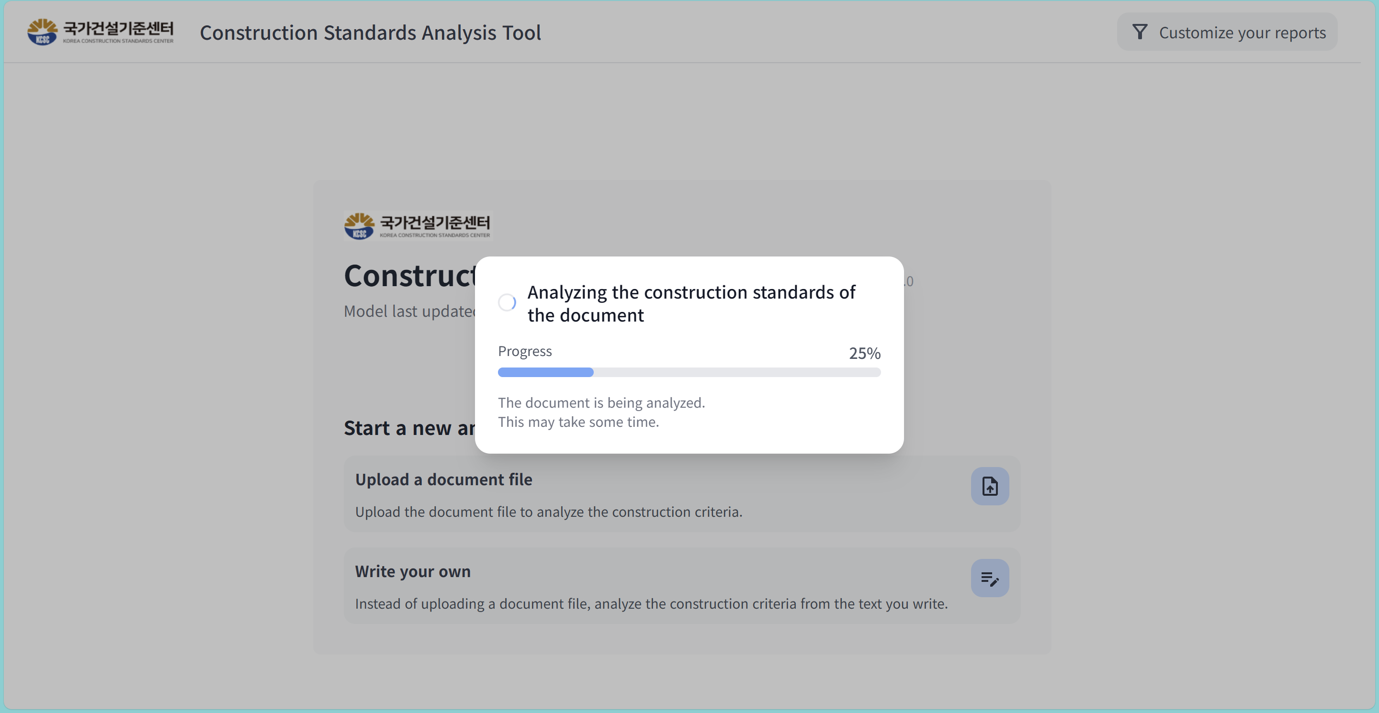
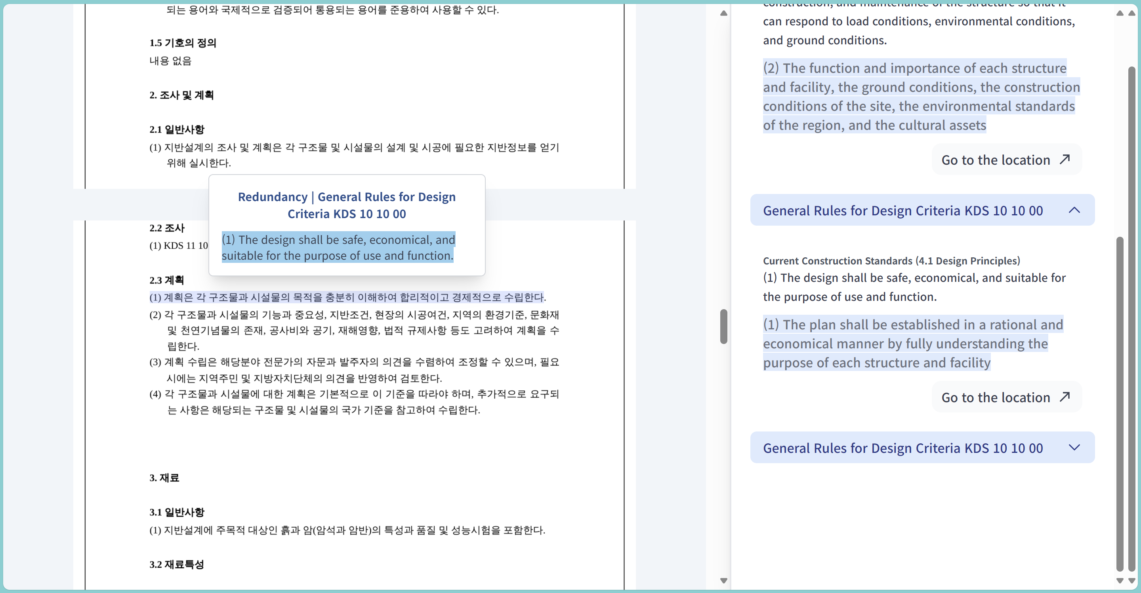
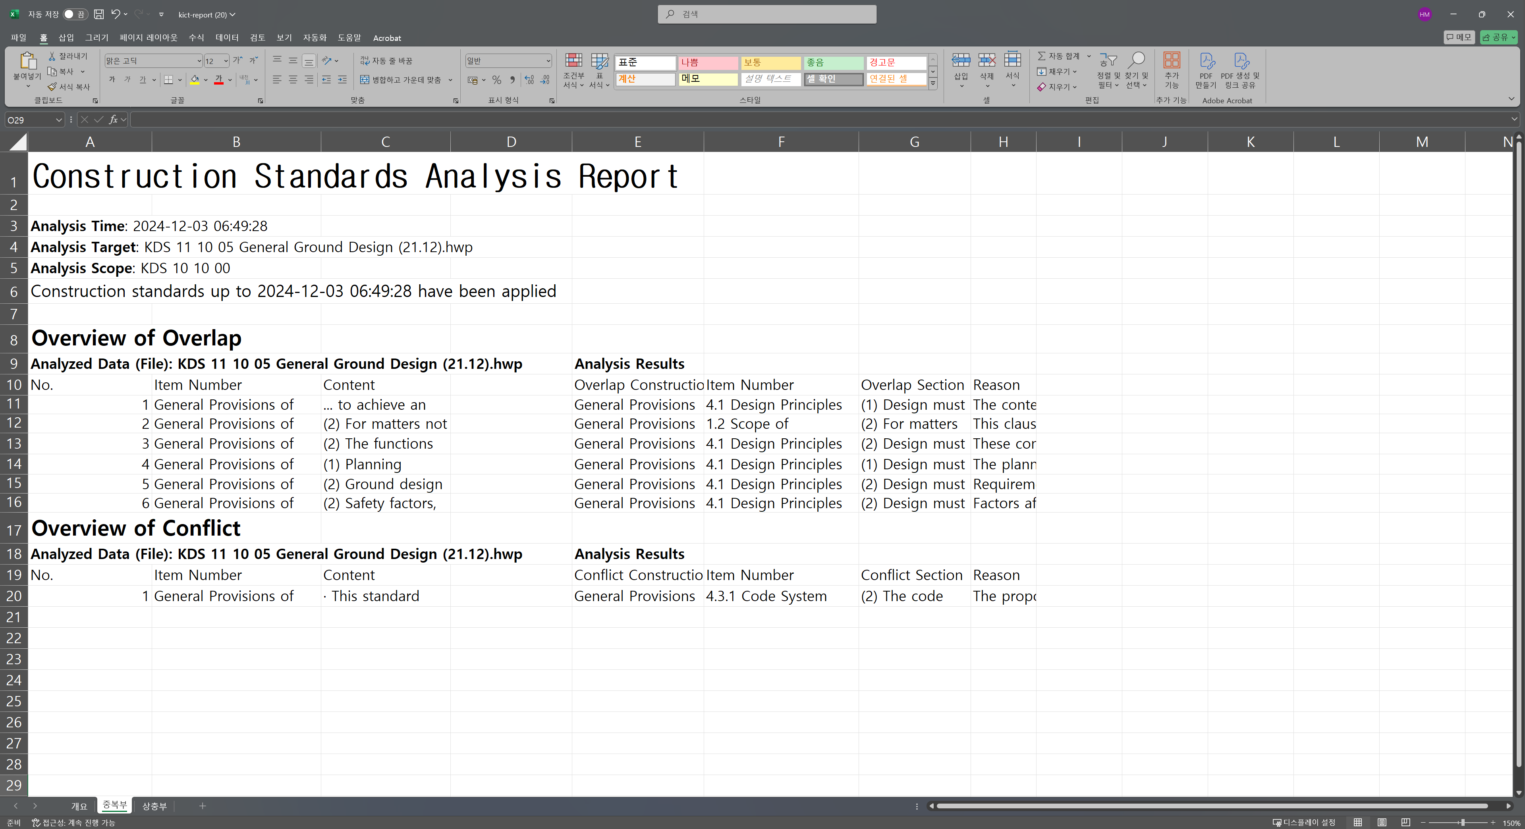
Conflict and Overlap Classification in Construction Standards Using a Large Language Model
Seong-Jin Park¹*, Youn-Gyu Jin¹*, Hyun-Young Moon¹*,
Bong-Hyuck Choi³, Seung-Hwan Lee³, Ohjoon Kwon⁴, Kang-Min Kim^{1,2}†
¹Department of Artificial Intelligence, ²Department of Data ScienceThe Catholic University of Korea, Bucheon, Republic of Korea
³Korea Institute of Civil Engineering and Building Technology, Goyang, Republic of Korea4Naver, Seongnam, Republic of Korea
{sjpark,wlsdbsrb,hyunyounge03,kangmin89}@catholic.ac.kr, {bhchoi,seunghwanlee}@kict.re.kr, ohjoon1209@gmail.com
* Equal contribution
† Corresponding author
1. Background
⌘
A
B
C
Construction standards are periodically updated to ensure safe, high-quality buildings.
However, their broad scope and interconnections often lead to overlapping or conflicting content.
Traditionally, experts handle these issues manually, but it's slow, costly, error-prone, and subjective.
While some countries reference existing standards or conduct regular reviews, yet heavy reliance on experts makes frequent revisions difficult.
D
2. Motivation
How can we supplement the expert-driven manual review process?
→ Domain-adapted LLM for NLI-based classification
of construction standards.
3. COSLLM Framework
5. Experimental results
ITRM: Since processing all sentence pairs via LLM is inefficient, ITRM pre-filters pairs with cosine similarity between embedded existing and revised standards. Below-threshold pairs are classified as neutrality, greatly reducing LLM inference costs while preserving detection accuracy.
Construction Domain-Specific LLM
Domain Adaptation: Qwen2-7B-Instruct is fine-tuned on a curated corpus of construction standards, research publications, and news articles using 10-epoch causal language modeling.
Two-step Classification
Step-1, Naive prediction: A construction domain-adapted LLM classifies sentence pairs into Overlap, Conflict, or Neutrality via instruction tuning with explicit task instructions and expert-reviewed examples.
Step-2, prediction with CoT: COSLLM adds [predict] for quick single-token predictions and [rationale] for complex inferences, defaulting to simple inference for neutral pairs and selectively enabling CoT for overlapping/conflicting pairs.
COSLLM Performance Comparison
COSLLM outperformed baseline models in classification
Even without augmented data, it maintained superior performance with 97.9% accuracy and a 0.907 macro-F1
6. Analysis
DA and IT significantly improve COSLLM’s performance, with IT being particularly impactful.
Selective CoT and ITRM enhance inference efficiency while preserving performance.
7. Conclusions
4. Real-Time Construction Standard Analysis System
We have proposed COSLLM, a domain-adapted LLM with CoT that resolves overlapping and conflicting content in construction standards.
We demonstrate the effectiveness of COSLLM through its high accuracy and efficiency, consistently outperforming baseline on real-world construction standard data.
This study highlights the practicality of COSLLM by developing and deploying COSLLM-powered analysis framework that enhances construction standard management supporting the efficient establishment and revision of standards.
Interactive Interface : ^{(a,b,c,d)}Users can upload drafts as PDFs or texts, ^{(e)}select relevant sections of existing standards, and ^{(f)} initiate analysis. ^{(g)}The system highlights overlapping or conflicting sentences in the draft, links them to corresponding standard codes, and ^{(h)}allows users to download a detailed report.
(a)
(b)
(c)
(d)
Overlap
(e)
(f)
(g)
(h)
References
Sun and Zhang., "Complex system modeling on establishment of construction standard system." Structural Survey 32.1, 2014.
Gao et al., SimCSE: Simple Contrastive Learning of Sentence Embeddings, EMNLP 2021.
Gururangan et al., Don’t Stop Pretraining: Adapt Language Models to Domains and Tasks, ACL 2020.
HSIEH et al., Distilling step-by-step! outperforming larger language models with less training data and smaller model sizes, ACL 2023.

Slide 3
(a)
(b)
(c)
(d)
(e)
(f)
Overlap
(g)
(h)

